Slide 1
Large Scale Infrastructure Intervention and Fake Testing
21 April 2018
Testing Meetup Saratov – Spring 2018
Build Software to Test Software
Tel: +7 495 640 2460, +1 415 830 38 49
exactpro.com

Slide 2
Introduction
Iosif Itkin
Started IT career 20 years ago as software developer
Moved into performance and load testing in 2006
Co-founded exactpro on 9th September 2009
Organized several QA Conferences – TMPA and EXTENT
Participated in a couple of software testing projects in 2017
Managed buyout from London Stock Exchange Group in 2018
Working on Build Software to Test Software Initiative

Slide 3
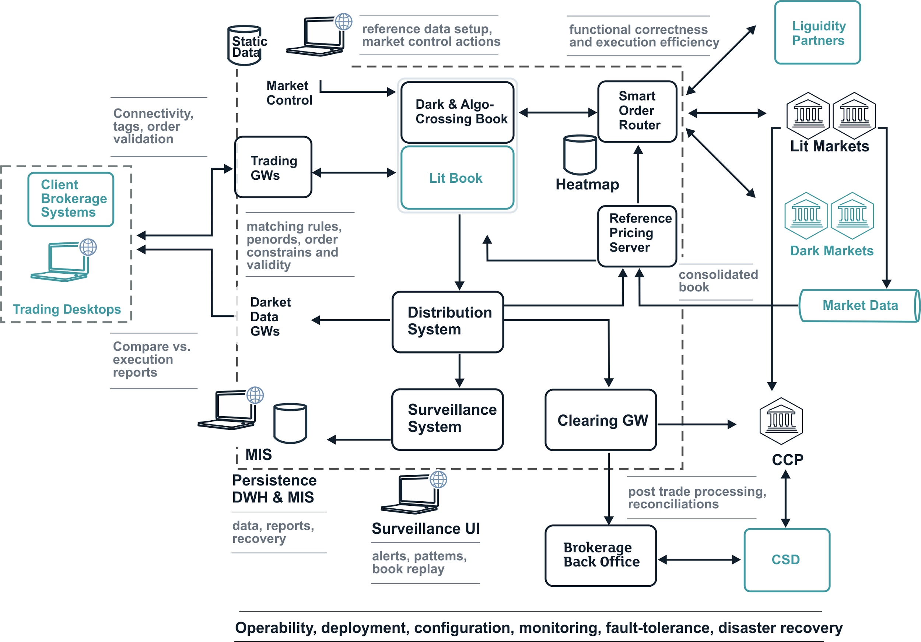
Large Scale Infrastructures

Slide 4
What is Fake Testing?
It can happen anywhere around you, so how to define it?

Slide 5
Software Testing That You Dislike
FAKE TESTING

Slide 6
Software Testing Definition
Providing objective, independent information about software quality
Process and tools and methods

Slide 7
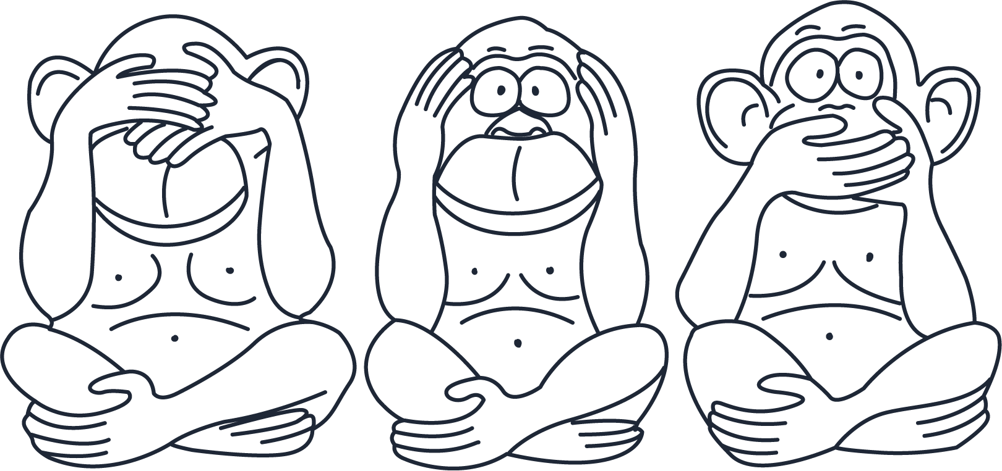
No Testing vs. Fake Testing

Slide 8
Software Testing is Relentless Learning

Slide 9
Do You Know Any Movie Where Software Tester Saves the World

Slide 10
Fake Testing vs. Real Testing

Slide 11
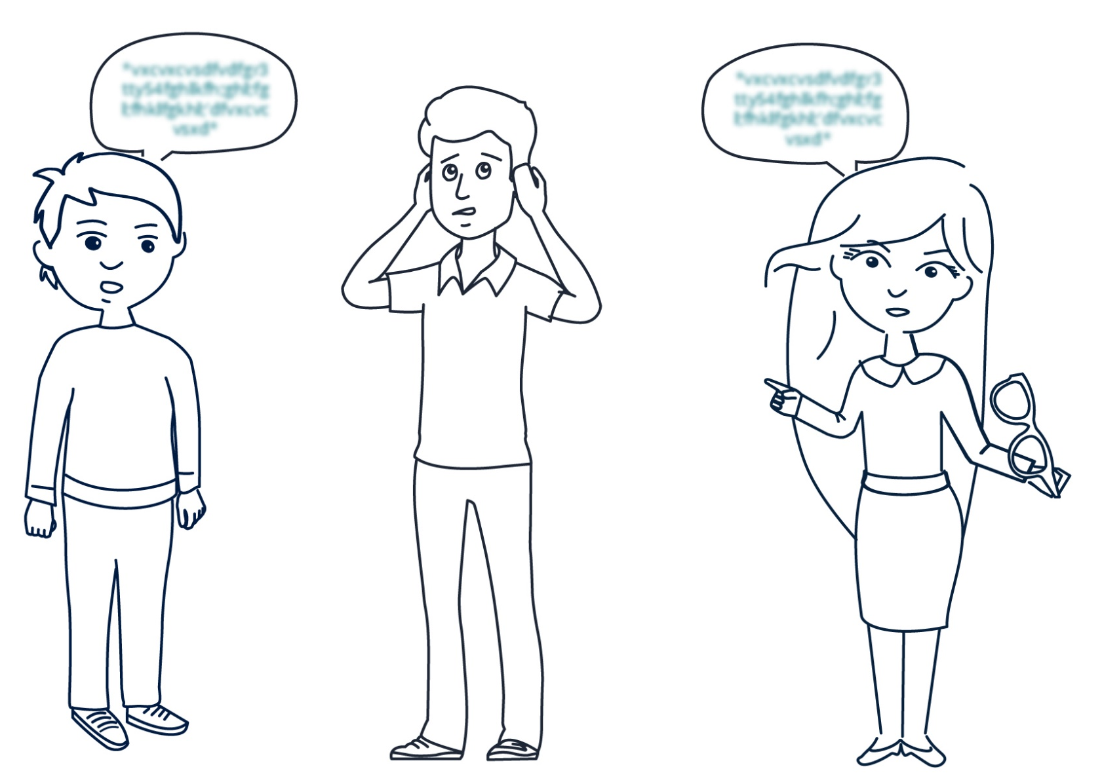
What if You Are Not Interested in Getting Real Feedback

Slide 12
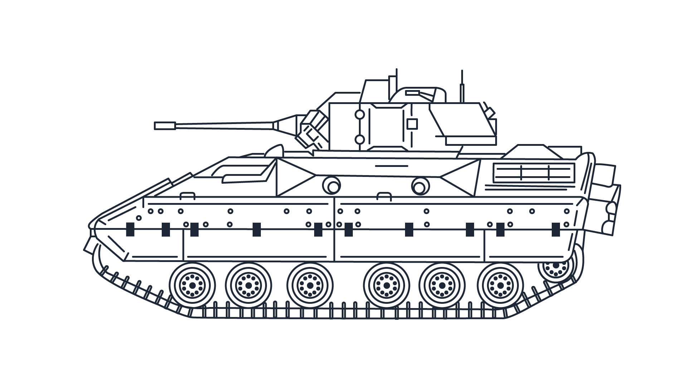
Live Fire Test
Burton strove for combat "realism" in tests and was focused on casualty prevention, urging Ballistic Research Laboratory (BRL) to conduct tests where the Bradley would stand, fully loaded and engine running, against overmatches- attacks with U.S. and Russian munitions that would clearly destroy the vehicle. BRL, on the other hand, wanted to test individual Bradley components in measured, incremental units using computerized vulnerability models. Burton also favored random angle ballistics testing, disagreeing with BRL’s method of testing against a computerized system and also with their rationale of conserving ammunition and "preventing extensive duplication" by using "preplanned shots to gather maximum information about selected vulnerabilities.
BradleyFightingVehicle-Scenario.pdf

Slide 13
Carefully Selected Ammunition

Slide 14
Carefully Selected Ammunition

Slide 15
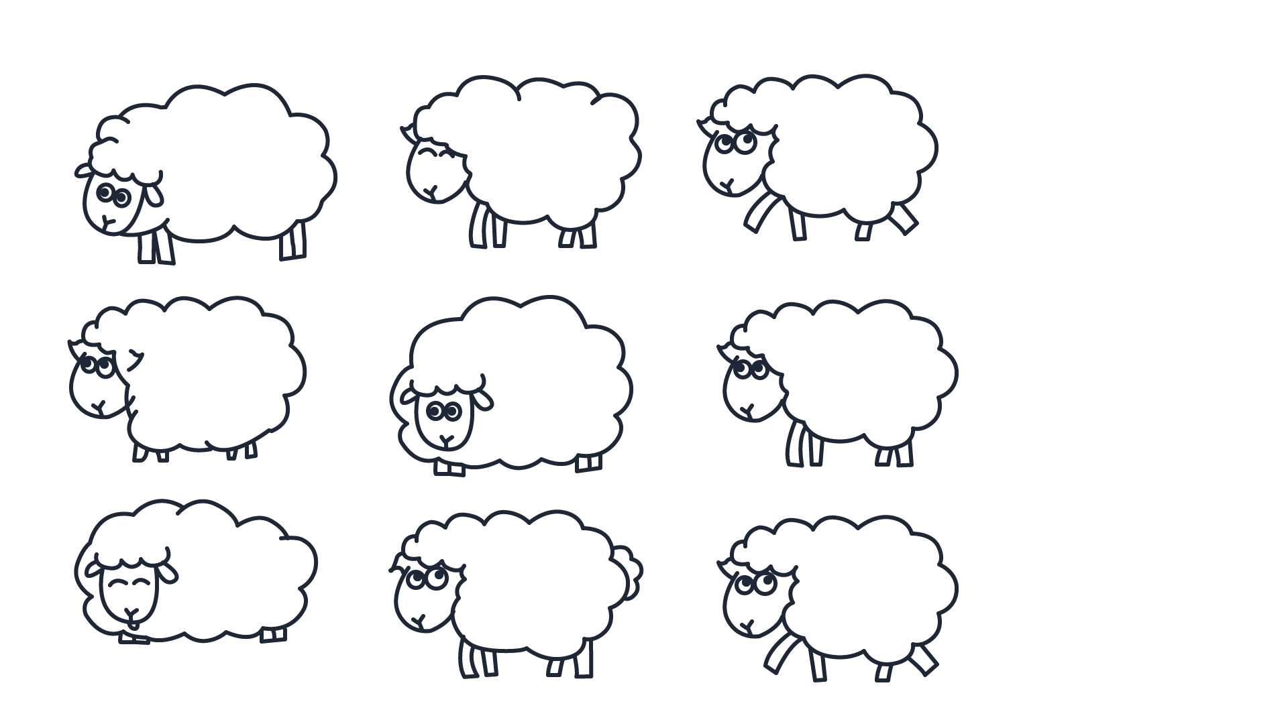
Preparing Tests in Advance

Slide 16
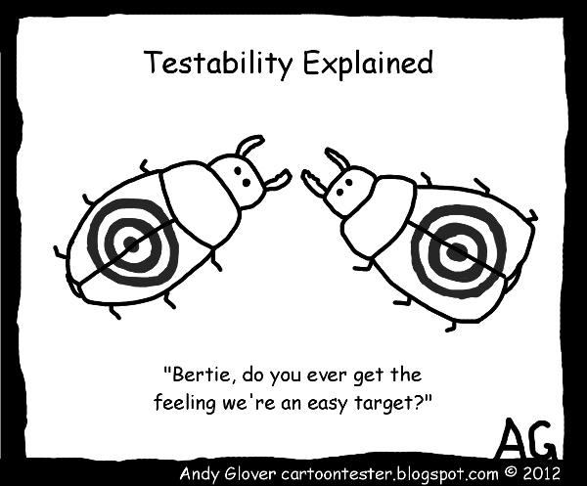
What is Testability

Slide 17
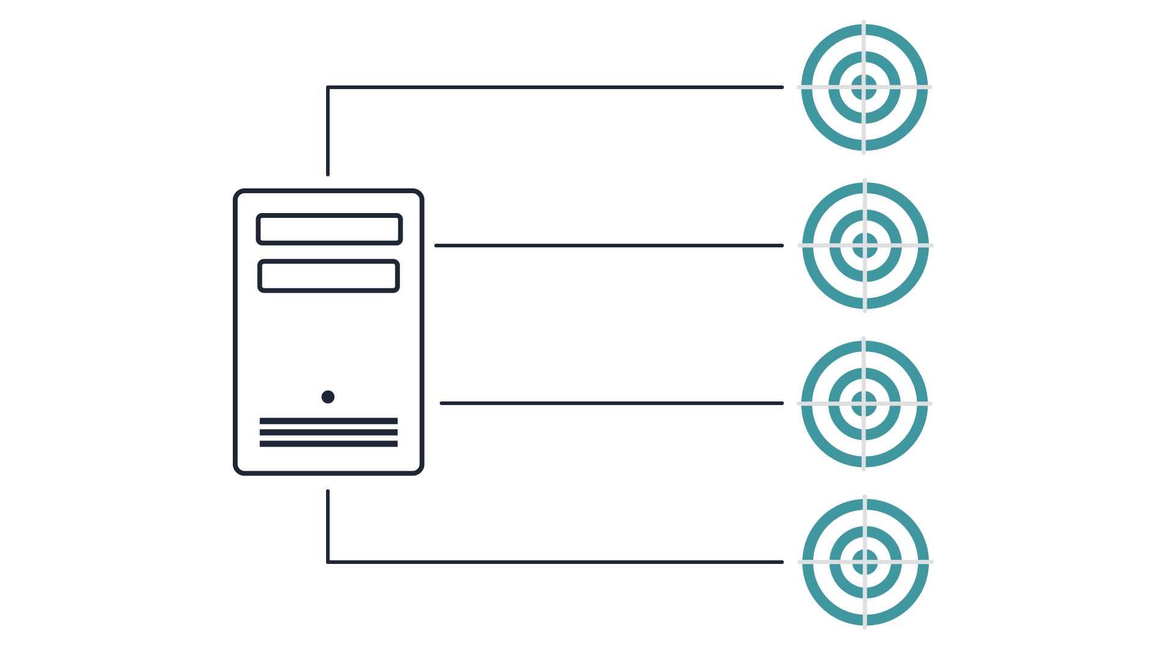
Real Testability

Slide 18
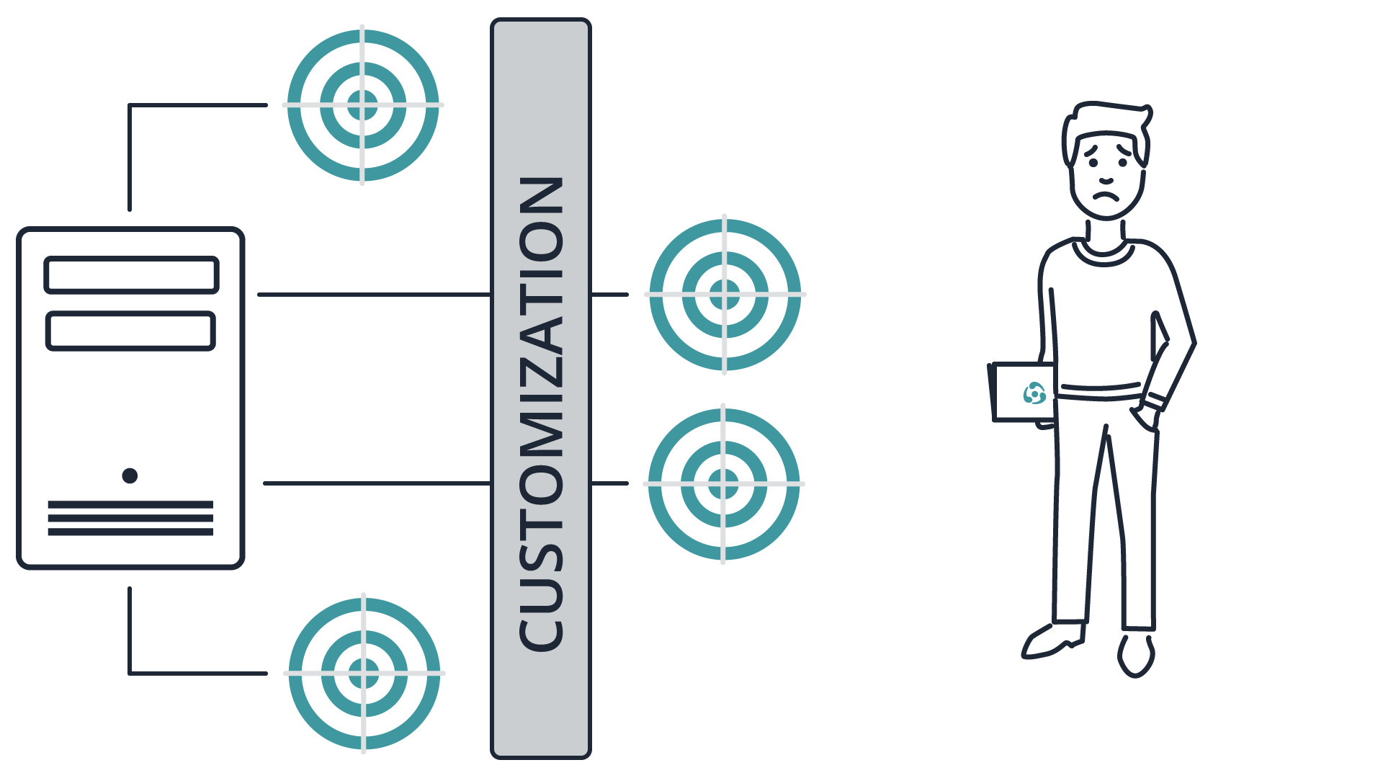
Fake Testability

Slide 19
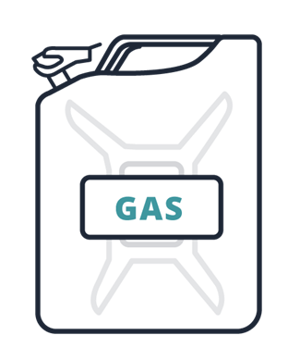
Testing Conditions

Slide 20
The World’s Most Valuable Commodity

Slide 21
What is the Fuel of the Modern Economy

Slide 22
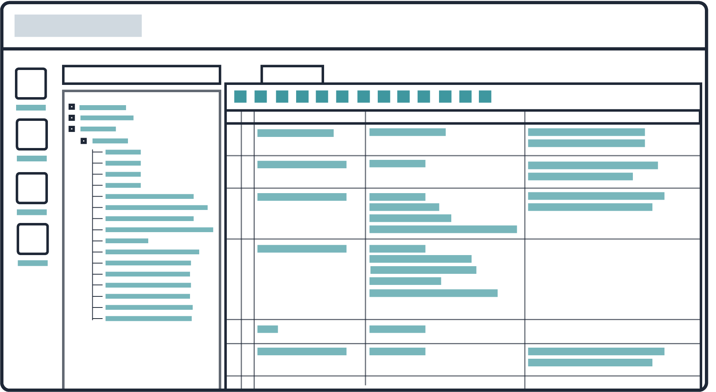
Functional Testing

Slide 23
Regression Testing

Slide 24
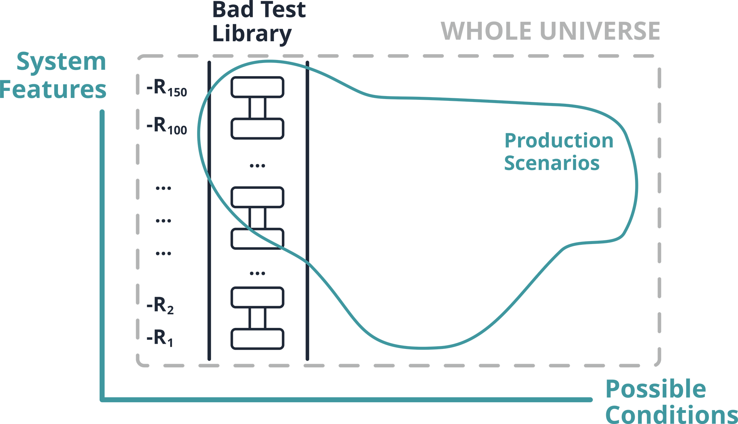
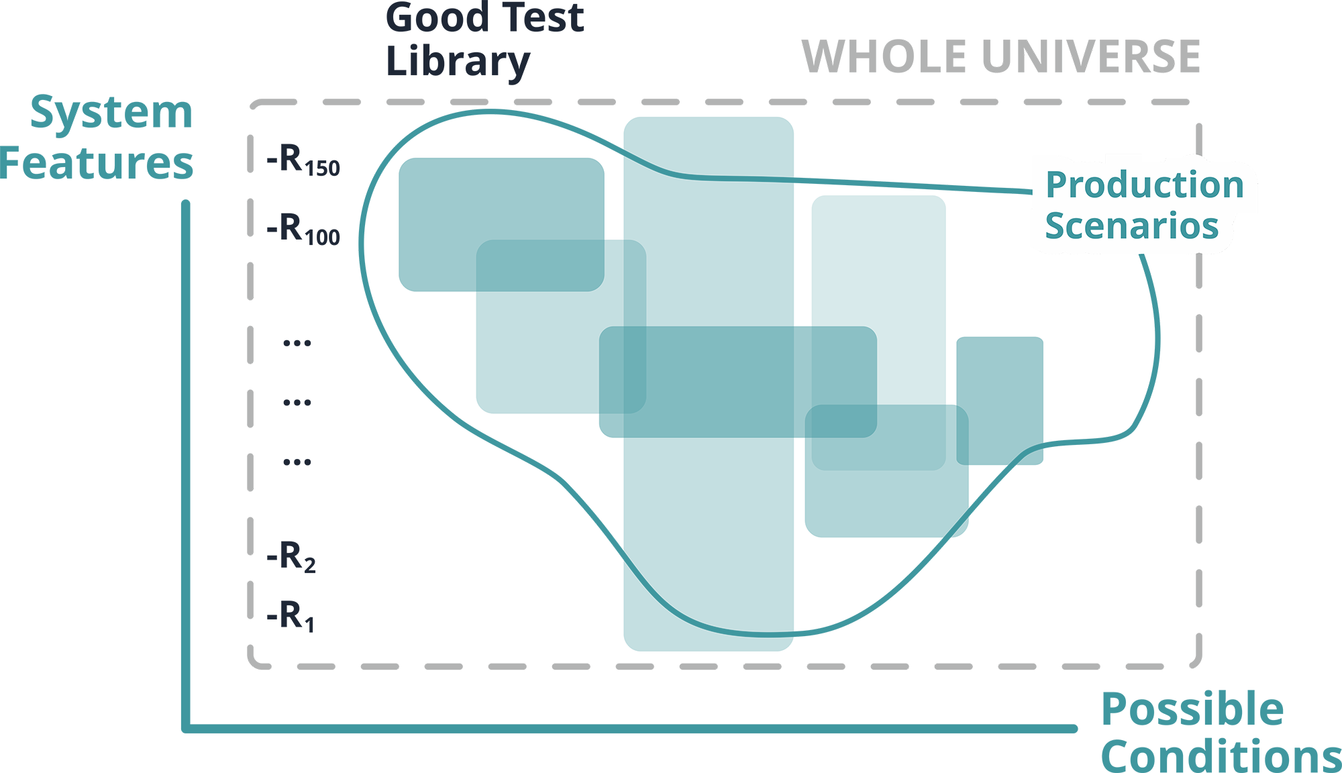
Test Coverage

Slide 25
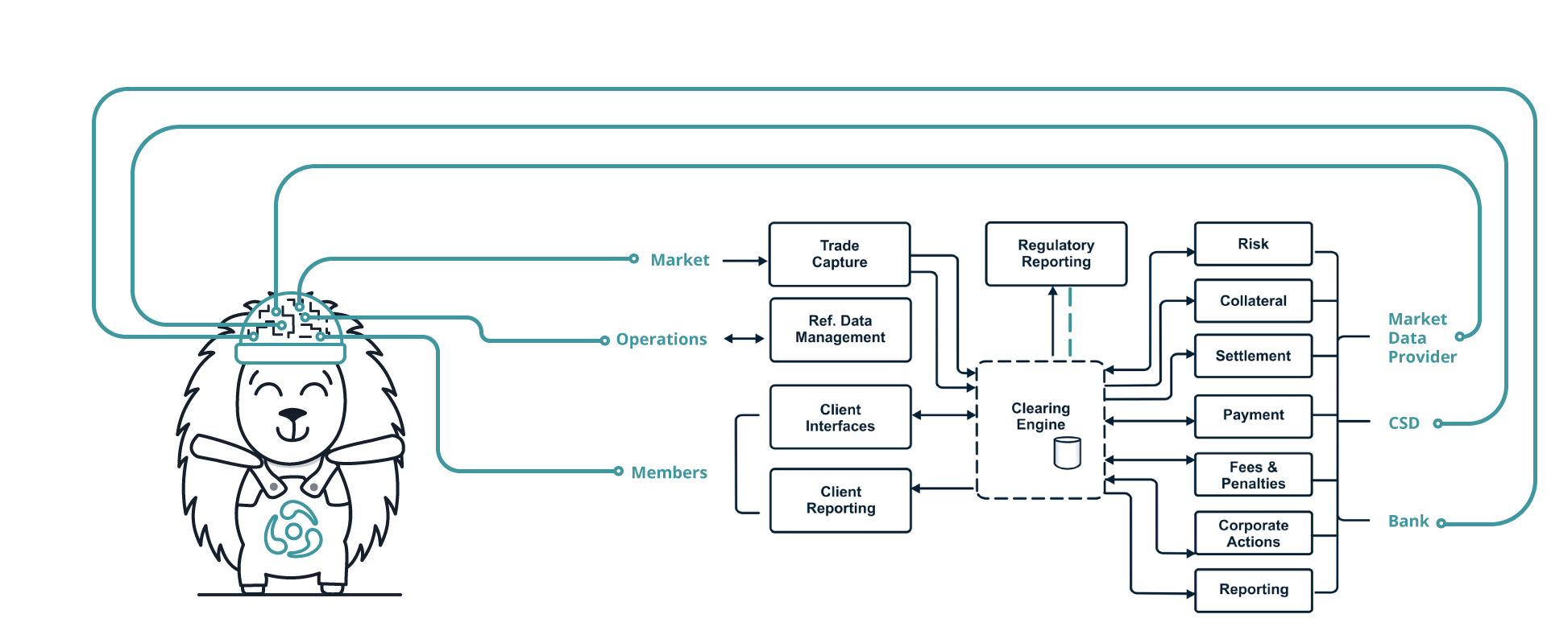
The Law of Requisite Variety

Slide 26
People Acting Irrationally
Xhosa cattle-killing movement
Nongqawuse met three spirits
1854 – 1858
At least 40,000 people starved to death

Slide 27
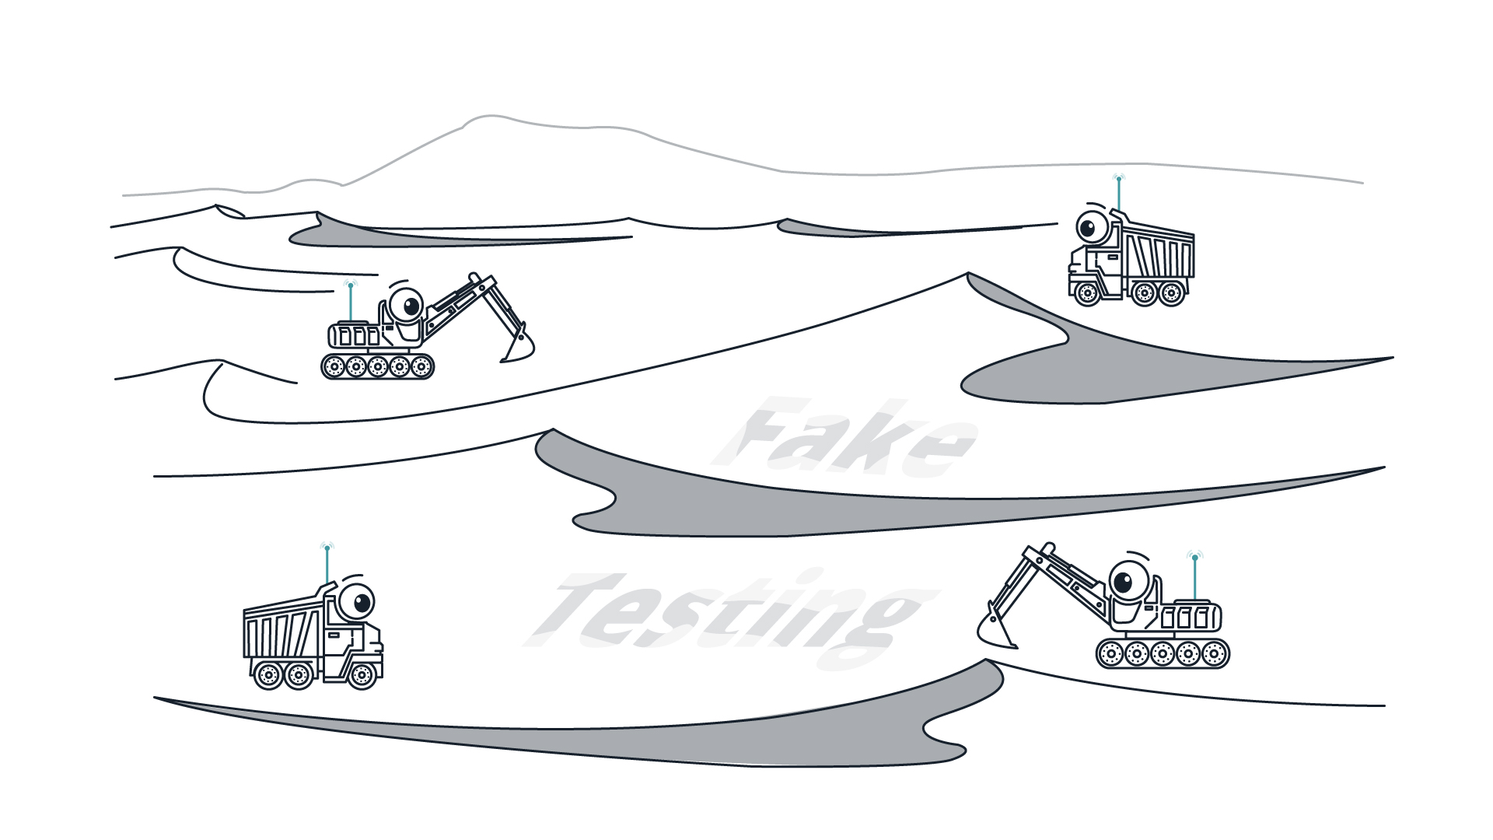
Fake Testing will Turn into Sand

Slide 28
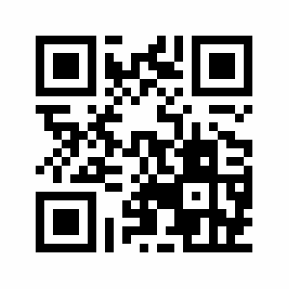
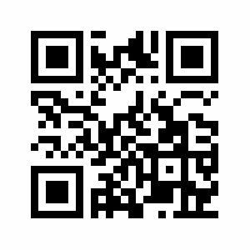
Thank You
https://t.me/QASaratov
https://vk.com/qasaratov

